Slide 1


MIE 1622: Robo-advisor
April 18, 2022
Pai Peng 1002725394
Liyan Liu 1002896100
Yiqi Fei 1003630314
Beishi He 1005039548
Zhengkun Chen 1004142331
Notes:
Hello everyone, this is group 4 presenting to you our robo-advisor project.

Slide 2
Content table
Product Overview
Chat-robot Design
DEMO WALK-THROUGH
Future
Notes:
The presentation is divided into 4 parts, firstly we will demonstrate the necessity of the product and discuss some advantages. Next we will explaine how the chat-bot is designed. Followed by A little demo to show you the workflow. And lastly, we’ll talk possible improvements in the future

Slide 3

Product Overview
01

Slide 4

The demand
Our Solution
With the pandemic and escalated international conflict , financial instability has continued to be a concern.
But this also creates window for benefiting from the recovery of economics..
People with financial awareness want to invest.
But where to start?
The Robo-advisor for Investment strategies !
What we offer:
1. Optimal portfolio tailored to individual needs .
2. Performance backed by historical look-back.
Our advantages over real agents: 1. Lower cost. 2. No middle man. 3. Instant response.4. Historical performance
Notes:
As many of you might have noticed, with the pandemic going continuously and recently escalated international conflict, global economics is just in a very uncertain state. Normally this is bad but for people with financial awareness, it might be a chance for them to benefit since recovering from recession indicates an upward trending market. But the problem is for those who wish to catch the opportunity, they might lack the knowledge to do so or the funding it takes to seek for professional advice.
Well, here is our solution. So what we are proposing is an online investment service that provides automated and algorithm-driven analysis based on client preference. An optimal portfolio and according reports will be delivered to the clients to help them make investment decision. The advantages of our product is obvious: you can expect a lower cost than consulting real-agent or have someone manage your money for which you normally would pay premium fees.. Moreover, it reduces human oversight to the minimum so that no middle-man is needed. Also the platform is online 24/7 so you can get an instant response any time so we really see the potential of our product as a financial service offered directly to the general public.

Slide 5

Chatbot
Design
02
Notes:
Now let me introduce how our chatbot is designed and the logic and chatting flows of the chatbot. As mentioned, customers will get their tailored portfolios by answering five questions asked by our chatbot.

Slide 6
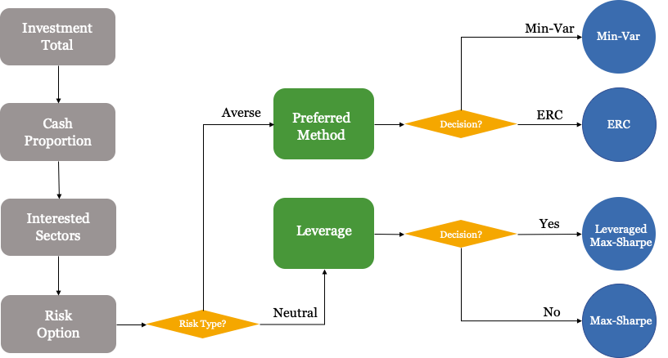
Question flow
Notes:
As shown in the flow chart, three basic questions will be asked to all the customers. We can gather customers' investment amounts, the minimum cash proportion they would like to keep in their portfolios, and the market sectors they are interested in investing in. The followed-up questions will have some variations based on different answers from the customers. They will first answer their risk preferences. For risk-averse customers who have low-risk tolerance and prefer to make slow but steady profits, we will provide conservative strategies. For risk-neutral customers, who focus on their potential gain, we will provide an aggressive investment strategy, and provide leverage options for them to choose from.

Slide 7
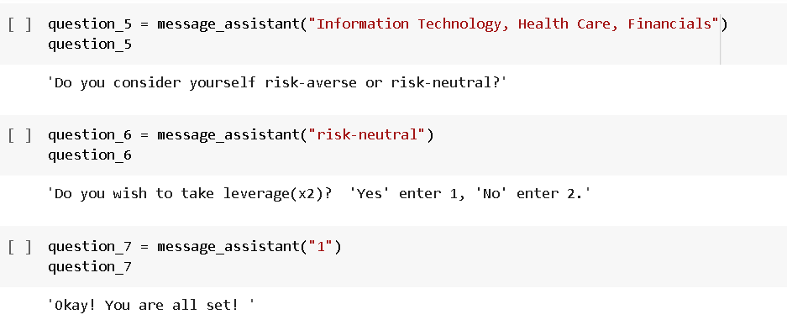
Some tech details – Chat Simulation
Check if the chat-robo behaves the way we expect it to.
Notes:
Here is an example of what customers would expect to get on their python end. As they answer all the questions, we gather their investment preference information and then can give tailored portfolios back to them.

Slide 8

Demo
Walk-through
03
Notes:
So, I am gonna walk you through our demo. So firstly, the client just needs to chat with the Watson assistant through the user interface to discuss the questions that we have designed.

Slide 9

Chat User Interface
Notes:
Here is a short demo video.

Slide 10
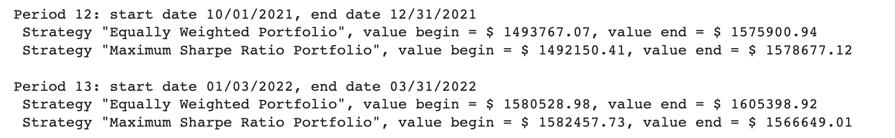
2. Backend process
After all the questions, the chat history is immediately communicated to the backend and informations are extracted accordingly.
Based on the above information, the program decides what strategy to apply and returns optimal portfolio, historical performance chart and etc.
Notes:
Once the conversation ends, the receipted answers will be immediately connected to the backend for processing, and making a portfolio that satisfies the client’s investment requirements. For example, here, by extracting the client’s information, our program will recognize their interested sectors and provide a list of efts to invest, as well as other useful settings. Then, our program will use those settings to simulate the portfolios and print out their portfolio values for all the periods.

Slide 11
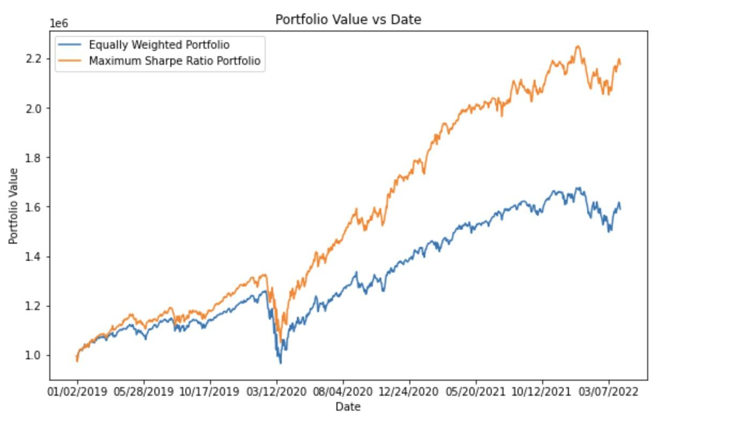
3. Deliverable
Portfolio value chart (2019-2022.4)
Average annual rate:
Strategy "Equally Weighted Portfolio", CAGR = 15.45%
Strategy "Maximum Sharpe Ratio Portfolio", CAGR = 27.15%
Portfolio weights(shares):
Notes:
Not only that, the program will also provide CAGRs and portfolio values chart as preferences so that the client can easily compare the performance of designed portfolio with the normal equally weighted portfolio. In the end, our program will give advice on the positions that our program will take if the client invests now.

Slide 12

Future
improvements
04
Notes:
So in the following chapter we are going to talk about things that can be improved given time.

Slide 13

Extensions to the chat-bot
Know you better
Delivery option
Premium Features
Extending questions: rebalance frequency, expected return, risk tolerance
Making delivery autonomous
In additional to investment strategy, recommendations, macro advise
Notes:
1. We keep the questions simple and compact for presentation purpose. But there are obviously much more questions can be asked to further explore the client preference. Things like how often they wish to rebalance their portfolio and so on.
2. We talked about how client preferences are received automatically. But we didn’t do much for delivering results. There can be a various ways to do so, we can chat the report to client in the chat box, we can email the result or we can just have them show up in their account history. So this is more of a product-wise optimization.
3. The product can do more than just receiving informations and compute portfolio weights. It can be more intelligent, things like giving general suggestions to client who wants to double his investment in 5 years. Or like giving recommendation when the client doesn’t have preference or knowl less about the ETF markets. There are just many features we can add to make it better. And for such premium features we can charge a higher price.

Slide 14

Extensions to the backend
Simulation
Up-to-date
data
Cutting-edge technology
Metric
Making delivery autonomous and in various way
Connecting to Yahoo Finance
Machine learning approach
Performance indicators: risk, max-drawdown, etc
Notes:
There are extensions available to the backend program as well
The data we use now are loaded from excels which contains market info until April 1st. But to actually make it more autonomous we want up-to-date data on daily basis. One way we can achieve this is by connect the program to some financial module like yahoo-finance library to request daily updates.
The clients obviously care more about the future than the past. Although we can’t time travel to see the future. We do have powerful simulation tools available that gives a rough idea of what to expect. Including this simulated analysis can help the chat-bot better illustrate to the clients of the performance to expect.
Thirdly. We used Max-sharpe ratio, min-var methods for optimization. They are good, closed-form solution but also a bit outdated. Machine learning has dominated in some area for a while now and we believe adoption OF some Multi-Factors deep-learning models can make a difference in performance..
Last but not least, So far we only include annualizaed return and portfolio value as ways to present to the client the profitability of the portfolio. But there can be more, things like Standard deviation, max-drawdowns and so on. With these additional evaluations, the clients get to fully understand the meaning behind their investment. And of course we can charge extra for the additional information provided.

Slide 15



Thanks for Watching
We will take your questions now

